Slide 1
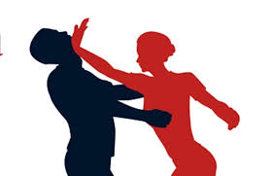
Introduction to Self Defense
By BJJ Black Belt Alex Vamos

Slide 2
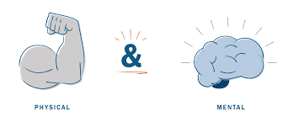
Types of Self Defense
Physical self defense
Mental self defense

Slide 3
Physical Self Defense
Physical Self-defense is the use of physical force to counter an immediate threat of violence. Such force can be either armed or unarmed. In either case, the chances of success depend on a large number of parameters, related to the severity of the threat on one hand, but also on the mental and physical preparedness of the defender

Slide 4
Mental Self Defense
Mental self defense is the ability to get into the proper mindset for executing a physical self defense technique. Many martial arts schools and self defense classes focus primarily on the physical nature of self defense but it’s very important to focus on the mental aspect as well

Slide 5
Awareness
Lessen Your Chances of Being a Victim
Be aware of your surrounding and situations that might be dangerous
Know how to avoid these situations
Know what choices to make if you find yourself in a potential situation
(walking on cellphone)

Slide 6
Four key self defense skills that you should be aware of are
Using your head
De-Escalating a bad situation
Reduce your risk
Taking self defense classes

Slide 7
Check out hangouts. Do they look safe? Are you comfortable being there? Ask yourself if the people around you seem to share your views on fun activities
If you think they’re being reckless, move on.
Be sure your body language shows a sense of confidence. Look like you know where you’re going and act alert

Slide 8
Trust your instincts
One way to avoid a potential attack before it happens is to trust your instincts.
Instincts combined with common sense can get you out of trouble.
Ex- If you are running alone on a school track and you suddenly feel like you are being watched, that could be your intuition telling you something. Your common sense would then tell you to go where there are more people around

Slide 9
Always, trust you instincts. If you feel uneasy in a situation do something about it, don’t worry about appearing foolish or overly cautious.
Believe in yourself. Have the strength to be independent. Don’t allow your self to be intimidated.

Slide 10
De- Escalating A Bad Situation
De-escalating a situation means speaking or acting in a way that can prevent things from getting worse.
Attackers aren’t always strangers who jump out of dark alleys. Sadly, we can be attacked by people we know. That’s where the skill of de-escalating a situation comes in

Slide 11
Why De-escalation works
Something as simple as not losing your temper can de-escalate a situation. Learn how to manage your own anger effectively so that you can talk or walk away without using your fists or weapons.

Slide 12
Although de-escalation won’t always work, it can only help matters if you remain calm and don’t give an attacker any extra ammunition. Whether it’s a stranger or someone you thought you could trust, saying and doing things that don’t threaten your attacker can give you some control

Slide 13
Reducing your risk
When you go out
- Make sure your are comfortable with the plans
Stay in group situations
Make sure you have your cellphone and your battery is charged
Let other people know your plans

Slide 14
When at Home
Keep entrances well lit
If someone comes to the door, never give the impression you are alone
Have doors locked
In your car
-Always have your keys out to be ready to get into your car
Lock doors right after entering
Park in well lit areas
Always lock your car

Slide 15
You can reduce your risks of being a victim by doing things that can help you stay safe
Make sure your friends and parents know your daily schedule (classes, sports practice, club meetings, etc.) If you go on a date or with friends for an after game snack, let someone know where you’re going and when you expect to return

Slide 16
Reasons Why Everyone Should Take Self Defense Training
Self defense training will build confidence.
Many people are unconfident with their abilities to protect themselves before they learn self defense
It helps develop self discipline
Which will help you be motivated and dedicated
It will make you more aware of your surroundings

Slide 17
You have the right to use reasonable force to prevent a crime including defending yourself.
What is reasonable force?
In a situation where you feel uncomfortable it is important to access the level of threat (no threat, low threat medium threat, high threat) and the appropriate response ot that threat. The level of force you respond with must be appropriate to the situation

Slide 18
Martial Art Self Defense Techniques
Striking
When it comes to Self Defense strikes and blows are some of the most common attacks.
Generally speaking, striking refers to your kicks, punches, head butts, knees, elbows and other attacks.

Slide 19
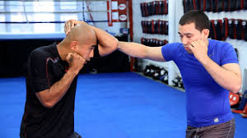
Blocks
Your opponent is most likely going to strike back. One of the martial arts techniques that you can use to minimize the an attack is a block. Blocking is the act of stopping your opponents strike before it is completed. The arms are most commonly used for blocking, but your legs can also be used at times.

Slide 20
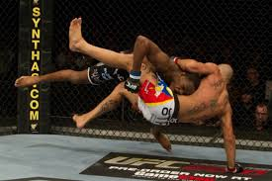
Takedowns
Takedowns occur when you actually bring your opponent to the ground. There are many different ways to accomplish a takedown.

Slide 21
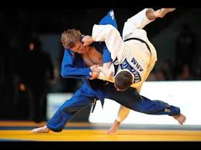
Throws
Throws are another form of takedowns. During a throw, you maneuver your body and legs to take down your opponent . The end result is that your opponent is brought to the ground.

Slide 22
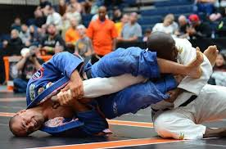
Submissions
The goal is to force your opponent to give up or submit.

Slide 23

Important Tips
When defending yourself always keep your hands up, and elbows down. This will give you the best defense for your body and head.

Slide 24
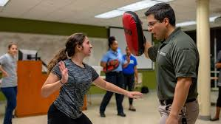
Take a Self Defense Class
The best way to prepare yourself to fight off an attacker is to take a self defense class. The more you practice techniques, the more confident you will feel applying its against a resisting opponent.

